Slide 1
Figures – Chapter 20

Slide 2
Figure 20.1 Stimuli and responses for a burglar alarm system
Stimulus | Response
Single sensor positive | Initiate alarm; turn on lights around site of positive sensor.
Two or more sensors positive | Initiate alarm; turn on lights around sites of positive sensors; call police with location of suspected break-in.
Voltage drop of between 10% and 20% | Switch to battery backup; run power supply test.
Voltage drop of more than 20% | Switch to battery backup; initiate alarm; call police; run power supply test.
Power supply failure | Call service technician.
Sensor failure | Call service technician.
Console panic button positive | Initiate alarm; turn on lights around console; call police.
Clear alarms | Switch off all active alarms; switch off all lights that have been switched on.

Slide 3
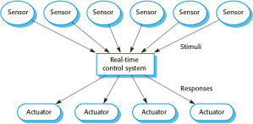
Figure 20.2 A general model of an embedded real-time system

Slide 4
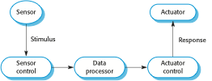
Figure 20.3 Sensor and actuator processes

Slide 5
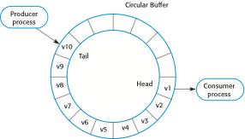
Figure 20.4 Producer/consumer processes sharing a circular buffer

Slide 6
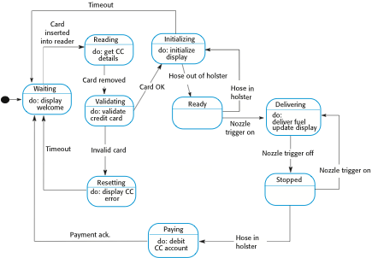
Figure 20.5 State machine model of a petrol (gas) pump

Slide 7
Figure 20.6 The Observe and React pattern
Name | Observe and React
Description | The input values of a set of sensors of the same types are collected and analyzed. These values are displayed in some way. If the sensor values indicate that some exceptional condition has arisen, then actions are initiated to draw the operator’s attention to that value and, in certain cases, to take actions in response to the exceptional value.
Stimuli | Values from sensors attached to the system.
Responses | Outputs to display, alarm triggers, signals to reacting systems.
Processes | Observer, Analysis, Display, Alarm, Reactor.
Used in | Monitoring systems, alarm systems.

Slide 8
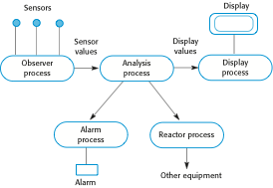
Figure 20.7 Observe and React process structure

Slide 9
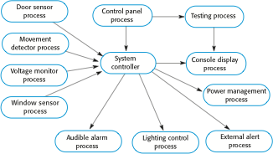
Figure 20.8 Process structure for a burglar alarm system

Slide 10
Figure 20.9 The Environmental Control pattern
Name | Environmental Control
Description | The system analyzes information from a set of sensors that collect data from the system’s environment. Further information may also be collected on the state of the actuators that are connected to the system. Based on the data from the sensors and actuators, control signals are sent to the actuators that then cause changes to the system’s environment. Information about the sensor values and the state of the actuators may be displayed.
Stimuli | Values from sensors attached to the system and the state of the system actuators.
Responses | Control signals to actuators, display information.
Processes | Monitor, Control, Display, Actuator Driver, Actuator monitor.
Used in | Control systems.

Slide 11
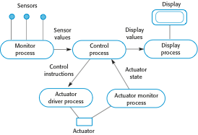
Figure 20.10 Environmental Control process structure

Slide 12
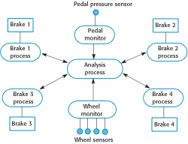
Figure 20.11 Control system architecture for an anti-skid braking system

Slide 13
Figure 20.12 The Process Pipeline pattern
Name | Process Pipeline
Description | A pipeline of processes is set up with data moving in sequence from one end of the pipeline to another. The processes are often linked by synchronized buffers to allow the producer and consumer processes to run at different speeds. The culmination of a pipeline may be display or data storage or the pipeline may terminate in an actuator.
Stimuli | Input values from the environment or some other process
Responses | Output values to the environment or a shared buffer
Processes | Producer, Buffer, Consumer
Used in | Data acquisition systems, multimedia systems

Slide 14

Figure 20.13 Process Pipeline process structure

Slide 15
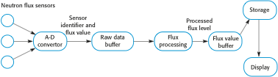
Figure 20.14 Neutron flux data acquisition

Slide 16
Figure 20.15 Timing requirements for the burglar alarm system
Stimulus/Response | Timing requirements
Power failure | The switch to backup power must be completed within a deadline of 50 ms.
Door alarm | Each door alarm should be polled twice per second.
Window alarm | Each window alarm should be polled twice per second.
Movement detector | Each movement detector should be polled twice per second.
Audible alarm | The audible alarm should be switched on within half a second of an alarm being raised by a sensor.
Lights switch | The lights should be switched on within half a second of an alarm being raised by a sensor.
Communications | The call to the police should be started within 2 seconds of an alarm being raised by a sensor.
Voice synthesizer | A synthesized message should be available within 2 seconds of an alarm being raised by a sensor.

Slide 17
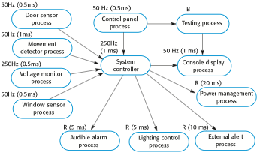
Figure 20.16 Alarm process timing

Slide 18
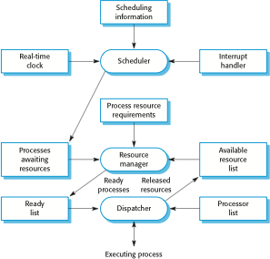
Figure 20.17 Components of a real-time operating system

Slide 19

Figure 20.18 RTOS actions required to start a process

Slide 20
Figure 20.19 Requirements for a train protection system
Train protection system
The system acquires information on the speed limit of a segment from a trackside transmitter, which continually broadcasts the segment identifier and its speed limit. The same transmitter also broadcasts information on the status of the signal controlling that track segment. The time required to broadcast track segment and signal information is 50 ms.
The train can receive information from the trackside transmitter when it is within 10 m of a transmitter.
The maximum train speed is 180 kph.
Sensors on the train provide information about the current train speed (updated every 250 ms) and the train brake status (updated every 100 ms).
If the train speed exceeds the current segment speed limit by more than 5 kph, a warning is sounded in the driver’s cabin. If the train speed exceeds the current segment speed limit by more than 10 kph, the train’s brakes are automatically applied until the speed falls to the segment speed limit. Train brakes should be applied within 100 ms of the time when the excessive train speed has been detected.
If the train enters a track segment that is signalled with a red light, the train protection system applies the train brakes and reduces the speed to zero. Train brakes should be applied within 100 ms of the time when the red light signal is received.
The system continually updates a status display in the driver’s cabin.

